Slide 1
Trie Trie (Prefix Tree, n-ary Tree)

Slide 2
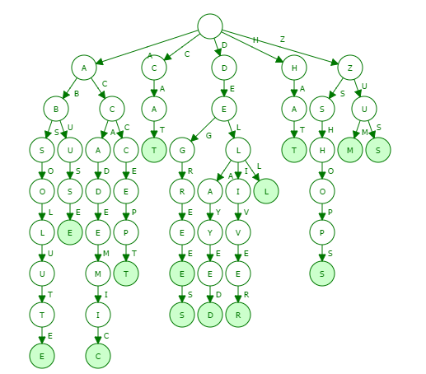
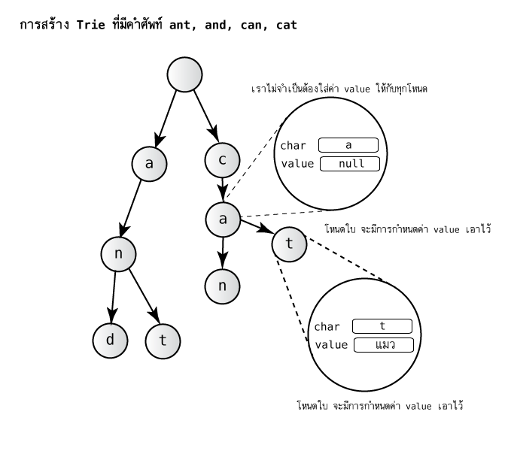
Visualizations: https://www.cs.usfca.edu/~galles/visualization/Trie.html

Slide 3
Insert, Time: O(length)
Delete, Time: O(length)
Destroyed, Time: O(length*n)
Replace, Time: O(length)
Search, Time: O(length)
List all words, Time: O(length*n)
Auto Complete, Time: < O(length*m)
* Before Word, Time: O(length*n)
String Matching, Time: O(length*n)

